Slide 1
A Guide to SQL, Ninth Edition
Chapter Six
Updating Data

Slide 2
Objectives
Create a new table from an existing table
Change data using the UPDATE command
Add new data using the INSERT command
Delete data using the DELETE command
Use nulls in UPDATE commands
©2016 Cengage Learning. All Rights Reserved. May not be copied, scanned, or duplicated, in whole or in part, except for use as permitted in a license distributed with a certain product or service or otherwise on a password-protected website for classroom use.

Slide 3
Objectives (continued)
Change the structure of an existing table
Use the COMMIT and ROLLBACK commands to make permanent data updates or to reverse updates
Understand transactions and the role of COMMIT and ROLLBACK in supporting transactions
Drop a table
©2016 Cengage Learning. All Rights Reserved. May not be copied, scanned, or duplicated, in whole or in part, except for use as permitted in a license distributed with a certain product or service or otherwise on a password-protected website for classroom use.

Slide 4
Creating a New Table from an Existing Table
Can create new table using an existing table
Use CREATE TABLE command
Can add query results to table by placing SELECT command in an INSERT command
©2016 Cengage Learning. All Rights Reserved. May not be copied, scanned, or duplicated, in whole or in part, except for use as permitted in a license distributed with a certain product or service or otherwise on a password-protected website for classroom use.

Slide 5
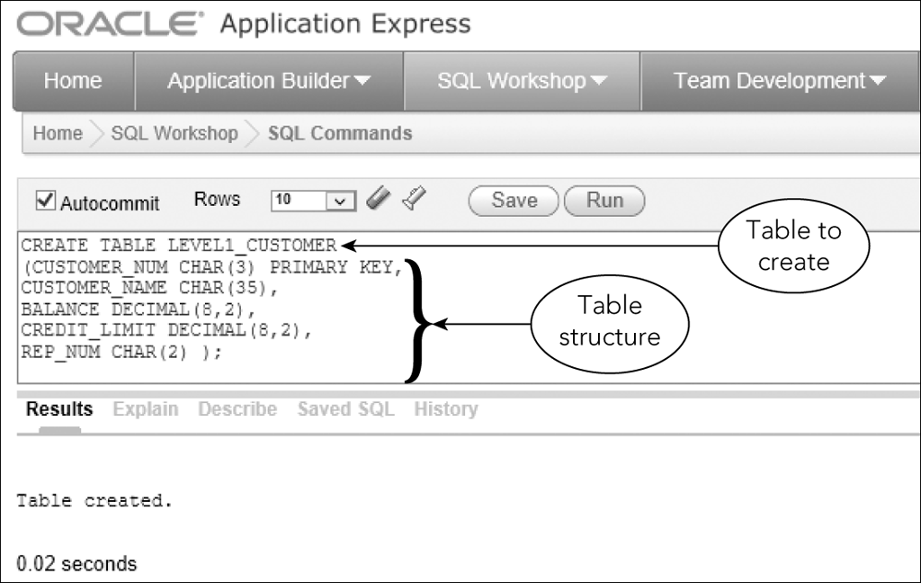
Creating a New Table from an Existing Table (continued)
Figure 6-1: Creating the LEVEL_1_CUSTOMER table
©2016 Cengage Learning. All Rights Reserved. May not be copied, scanned, or duplicated, in whole or in part, except for use as permitted in a license distributed with a certain product or service or otherwise on a password-protected website for classroom use.

Slide 6
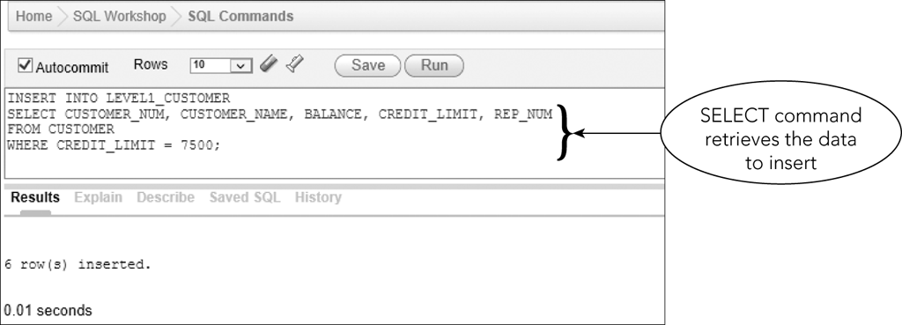
Creating a New Table from an Existing Table (continued)
Figure 6-2: INSERT command to add data to the LEVEL_1_CUSTOMER table
©2016 Cengage Learning. All Rights Reserved. May not be copied, scanned, or duplicated, in whole or in part, except for use as permitted in a license distributed with a certain product or service or otherwise on a password-protected website for classroom use.

Slide 7
Changing Existing Data in a Table
Use UPDATE command to change rows for which a specific condition is true
  Simple or compound condition
Command format
  UPDATE (name of table to be updated)
  SET (name of the column to be
  updated = new value)
    Can include a calculation
©2016 Cengage Learning. All Rights Reserved. May not be copied, scanned, or duplicated, in whole or in part, except for use as permitted in a license distributed with a certain product or service or otherwise on a password-protected website for classroom use.

Slide 8
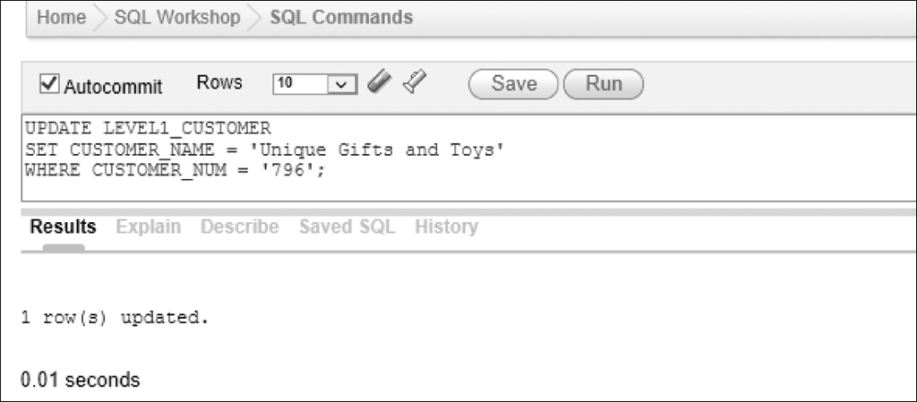
Changing Existing Data in a Table (continued)
Simple Condition
Figure 6-4: UPDATE command to change the name of customer 796
©2016 Cengage Learning. All Rights Reserved. May not be copied, scanned, or duplicated, in whole or in part, except for use as permitted in a license distributed with a certain product or service or otherwise on a password-protected website for classroom use.

Slide 9
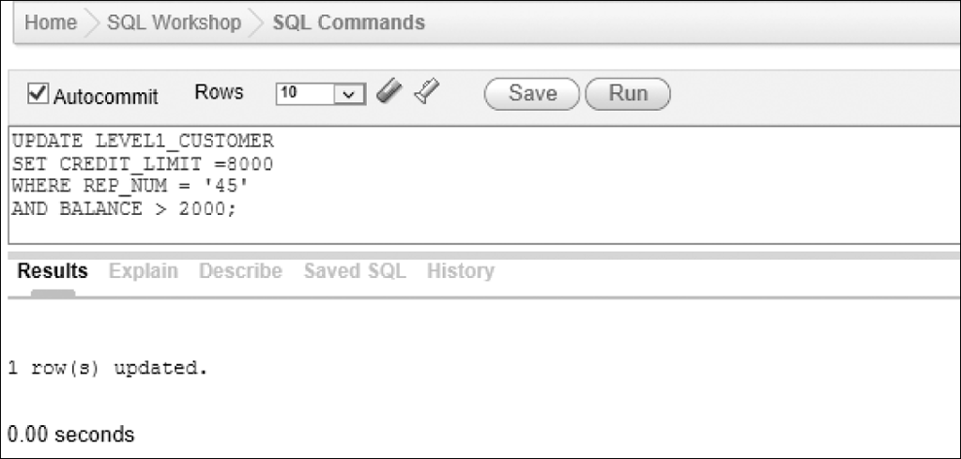
Changing Existing Data in a Table (continued)
Compound Condition
Figure 6-6: Using a compound condition in an update
©2016 Cengage Learning. All Rights Reserved. May not be copied, scanned, or duplicated, in whole or in part, except for use as permitted in a license distributed with a certain product or service or otherwise on a password-protected website for classroom use.

Slide 10
Adding New Rows to an Existing Table
Use the INSERT command to add additional data to a table
Use the SELECT command to verify rows were added correctly
©2016 Cengage Learning. All Rights Reserved. May not be copied, scanned, or duplicated, in whole or in part, except for use as permitted in a license distributed with a certain product or service or otherwise on a password-protected website for classroom use.

Slide 11
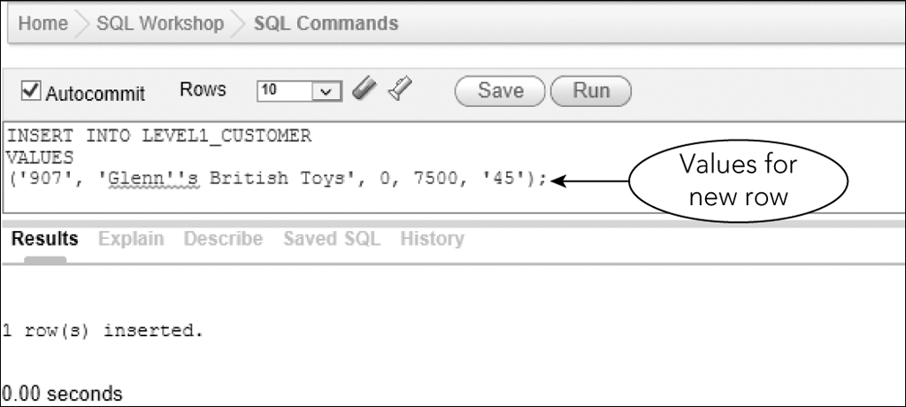
Adding New Rows to an Existing Table (continued)
Figure 6-8: Inserting a row
©2016 Cengage Learning. All Rights Reserved. May not be copied, scanned, or duplicated, in whole or in part, except for use as permitted in a license distributed with a certain product or service or otherwise on a password-protected website for classroom use.

Slide 12
AUTOCOMMIT, COMMIT, and ROLLBACK
Autocommit is default transaction mode
  Commits each action query as soon as the user executes each query
  Clear check mark to turn off Autocommit in Oracle
Multi-user database applications require more control over transactions
©2016 Cengage Learning. All Rights Reserved. May not be copied, scanned, or duplicated, in whole or in part, except for use as permitted in a license distributed with a certain product or service or otherwise on a password-protected website for classroom use.

Slide 13
AUTOCOMMIT, COMMIT, and ROLLBACK (continued)
Updates to a table are only temporary
  Can cancel during current work session
COMMIT command
  Saves changes immediately during current session
ROLLBACK command
  Reverses the changes made since last COMMIT command or in current work session
©2016 Cengage Learning. All Rights Reserved. May not be copied, scanned, or duplicated, in whole or in part, except for use as permitted in a license distributed with a certain product or service or otherwise on a password-protected website for classroom use.

Slide 14
AUTOCOMMIT, COMMIT, and ROLLBACK (continued)
ROLLBACK command only reverses changes made to data
COMMIT command is permanent
  Running ROLLBACK after COMMIT cannot reverse the update
©2016 Cengage Learning. All Rights Reserved. May not be copied, scanned, or duplicated, in whole or in part, except for use as permitted in a license distributed with a certain product or service or otherwise on a password-protected website for classroom use.

Slide 15
Transactions
A transaction is a logical unit of work
  A sequence of steps that accomplish a single task
  Essential that the entire sequence be completed successfully
COMMIT and ROLLBACK commands support transactions
©2016 Cengage Learning. All Rights Reserved. May not be copied, scanned, or duplicated, in whole or in part, except for use as permitted in a license distributed with a certain product or service or otherwise on a password-protected website for classroom use.

Slide 16
Transactions (continued)
Before starting updates for a transaction, COMMIT any previous updates
Complete the updates for the transaction
  If it cannot be completed, use ROLLBACK
If all updates complete, use COMMIT again
©2016 Cengage Learning. All Rights Reserved. May not be copied, scanned, or duplicated, in whole or in part, except for use as permitted in a license distributed with a certain product or service or otherwise on a password-protected website for classroom use.

Slide 17
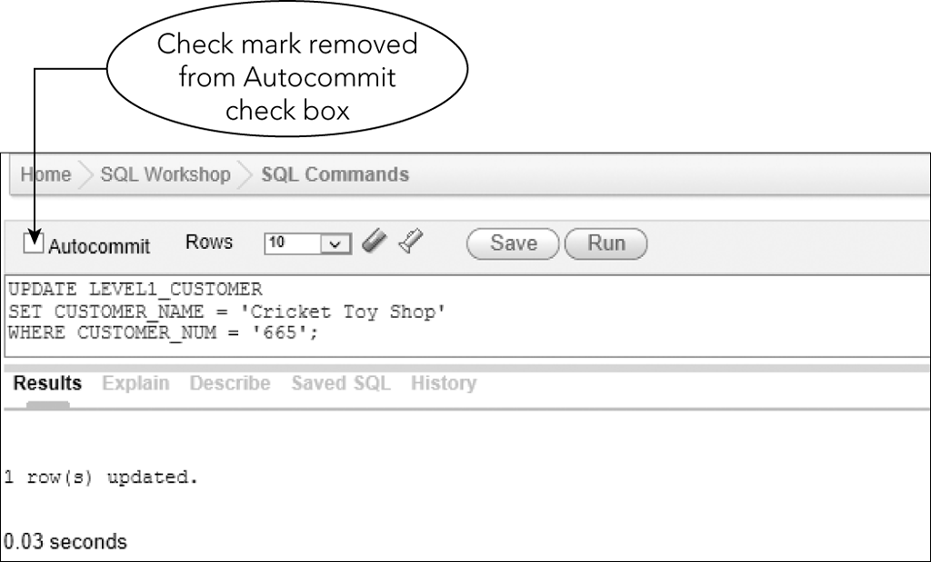
Changing and Deleting Existing Rows
Autocommit is turned off
Figure 6-10 Using an UPDATE command to change the name of customer 665
©2016 Cengage Learning. All Rights Reserved. May not be copied, scanned, or duplicated, in whole or in part, except for use as permitted in a license distributed with a certain product or service or otherwise on a password-protected website for classroom use.

Slide 18
Changing and Deleting Existing Rows (continued)
Use DELETE command to delete data from database
Command format
  DELETE (table from which the row(s) is to be deleted)
  WHERE clause (with a condition to select the row(s) to delete)
All rows satisfying the condition will be deleted
If no condition, then all rows deleted
©2016 Cengage Learning. All Rights Reserved. May not be copied, scanned, or duplicated, in whole or in part, except for use as permitted in a license distributed with a certain product or service or otherwise on a password-protected website for classroom use.

Slide 19
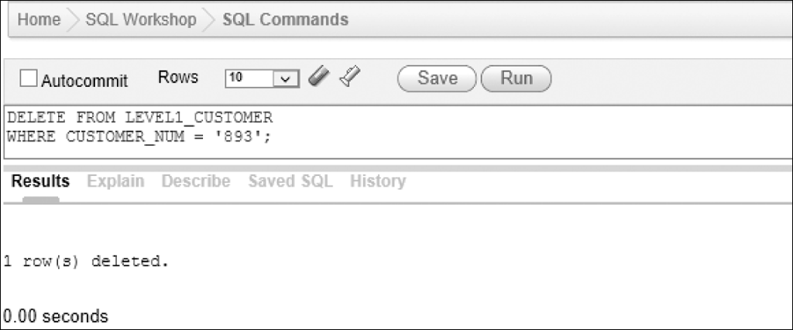
Changing and Deleting Existing Rows (continued)
Autocommit is turned off
Figure 6-11: Using DELETE command to delete customer 893
©2016 Cengage Learning. All Rights Reserved. May not be copied, scanned, or duplicated, in whole or in part, except for use as permitted in a license distributed with a certain product or service or otherwise on a password-protected website for classroom use.

Slide 20
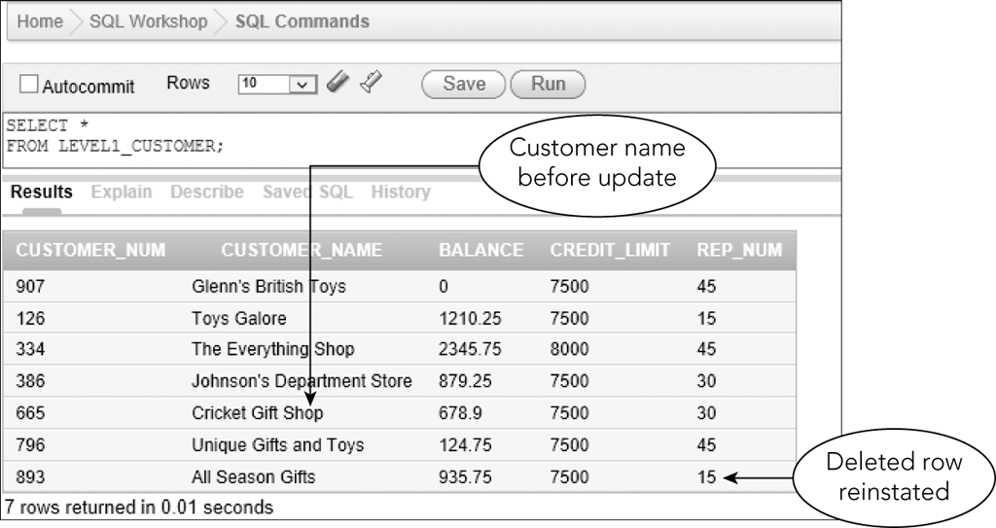
Executing a Rollback
ROLLBACK command
Figure 6-14: Data in the LEVEL_1_CUSTOMER table after executing a rollback
©2016 Cengage Learning. All Rights Reserved. May not be copied, scanned, or duplicated, in whole or in part, except for use as permitted in a license distributed with a certain product or service or otherwise on a password-protected website for classroom use.

Slide 21
Changing a Value in a Column to Null
Command for changing value to null is the same as changing any other value
Affected column must be able to accept nulls
Use the value NULL as the replacement value
©2016 Cengage Learning. All Rights Reserved. May not be copied, scanned, or duplicated, in whole or in part, except for use as permitted in a license distributed with a certain product or service or otherwise on a password-protected website for classroom use.

Slide 22
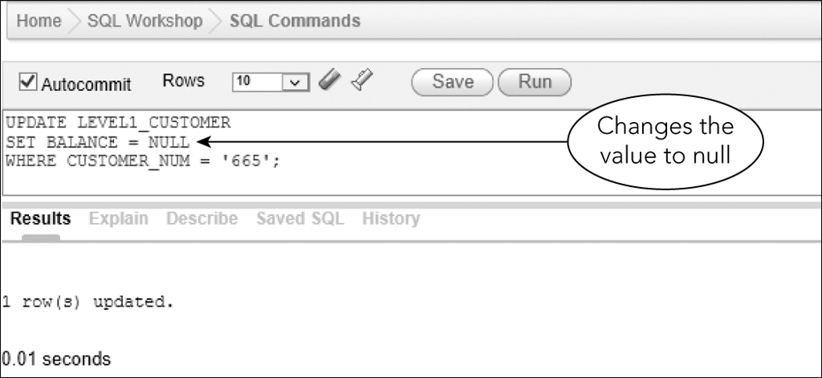
Changing a Value in a Column to Null (continued)
Figure 6-15: Changing a value in a column to null
©2016 Cengage Learning. All Rights Reserved. May not be copied, scanned, or duplicated, in whole or in part, except for use as permitted in a license distributed with a certain product or service or otherwise on a password-protected website for classroom use.

Slide 23
Changing a Table’s Structure
Add new tables
Delete tables no longer required
Add new columns to a table
Change physical characteristics of existing columns
©2016 Cengage Learning. All Rights Reserved. May not be copied, scanned, or duplicated, in whole or in part, except for use as permitted in a license distributed with a certain product or service or otherwise on a password-protected website for classroom use.

Slide 24
Changing a Table’s Structure (continued)
ALTER TABLE command allows for changing a table’s structure
Use ADD clause to add a new column
  ADD clause is followed by the name of column to be added, followed by its characteristics
©2016 Cengage Learning. All Rights Reserved. May not be copied, scanned, or duplicated, in whole or in part, except for use as permitted in a license distributed with a certain product or service or otherwise on a password-protected website for classroom use.

Slide 25
Changing a Table’s Structure (continued)
Assign value to new column
  Simplest approach is to assign NULL as the value
Or use an UPDATE command
  Change all rows to most common value
  Change individual rows
©2016 Cengage Learning. All Rights Reserved. May not be copied, scanned, or duplicated, in whole or in part, except for use as permitted in a license distributed with a certain product or service or otherwise on a password-protected website for classroom use.

Slide 26
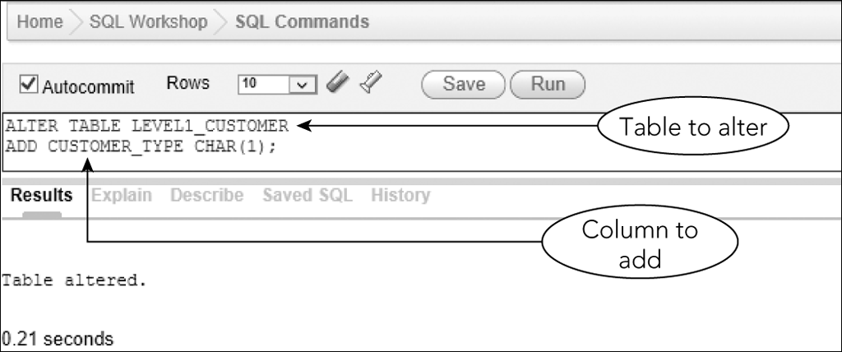
Changing a Table’s Structure (continued)
Figure 6-17: Adding a column to an existing table
©2016 Cengage Learning. All Rights Reserved. May not be copied, scanned, or duplicated, in whole or in part, except for use as permitted in a license distributed with a certain product or service or otherwise on a password-protected website for classroom use.

Slide 27
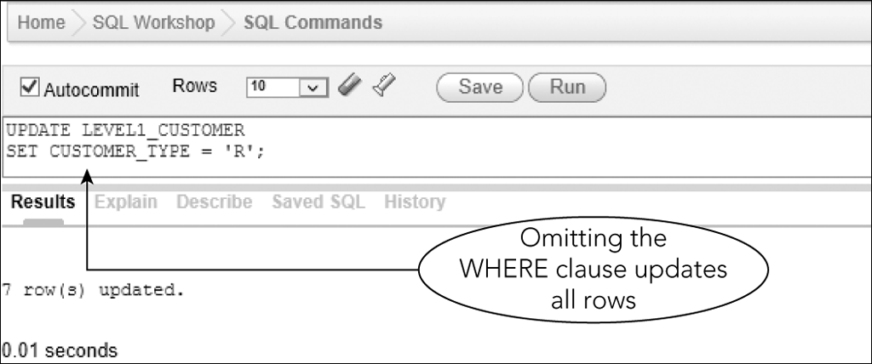
Changing a Table’s Structure (continued)
Figure 6-18: Make the same update for all rows
©2016 Cengage Learning. All Rights Reserved. May not be copied, scanned, or duplicated, in whole or in part, except for use as permitted in a license distributed with a certain product or service or otherwise on a password-protected website for classroom use.

Slide 28
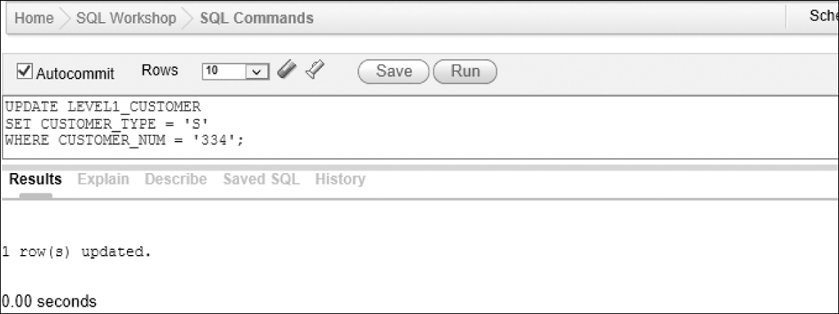
Changing a Table’s Structure (continued)
Figure 6-20: Updating customer 334 to customer type S
©2016 Cengage Learning. All Rights Reserved. May not be copied, scanned, or duplicated, in whole or in part, except for use as permitted in a license distributed with a certain product or service or otherwise on a password-protected website for classroom use.

Slide 29
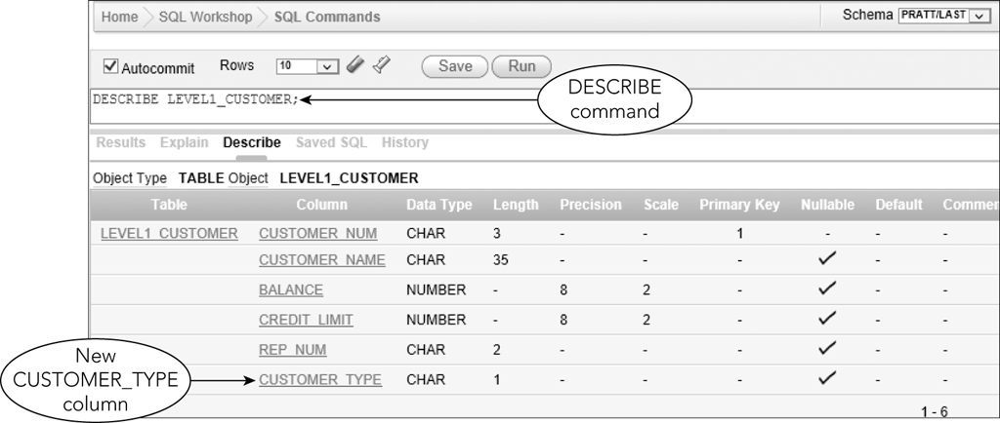
Changing a Table’s Structure (continued)
Figure 6-23: Structure of the LEVEL_1_CUSTOMER table
©2016 Cengage Learning. All Rights Reserved. May not be copied, scanned, or duplicated, in whole or in part, except for use as permitted in a license distributed with a certain product or service or otherwise on a password-protected website for classroom use.

Slide 30
Changing a Table’s Structure (continued)
MODIFY clause of ALTER TABLE command changes characteristics of existing columns
Can use to change a column that currently rejects null values
  Use NULL in place of NOT NULL
Can increase and decrease size of column
©2016 Cengage Learning. All Rights Reserved. May not be copied, scanned, or duplicated, in whole or in part, except for use as permitted in a license distributed with a certain product or service or otherwise on a password-protected website for classroom use.

Slide 31
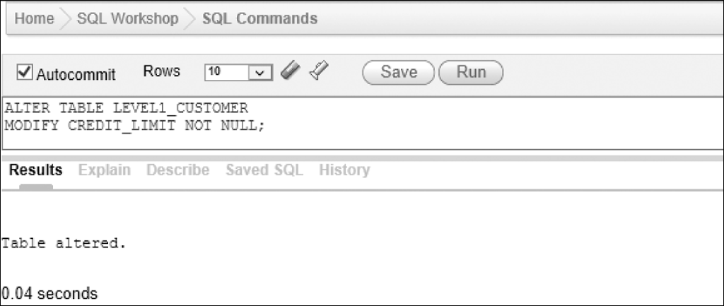
Changing a Table’s Structure (continued)
Figure 6-25: Changing the CREDIT_LIMIT column in the LEVEL_1_CUSTOMER table to reject null values
©2016 Cengage Learning. All Rights Reserved. May not be copied, scanned, or duplicated, in whole or in part, except for use as permitted in a license distributed with a certain product or service or otherwise on a password-protected website for classroom use.

Slide 32
Making Complex Changes
Changes to table structure may be beyond the capabilities of SQL
  Eliminate multiple columns
  Change column order
  Combine data from two tables to one
Create a new table
©2016 Cengage Learning. All Rights Reserved. May not be copied, scanned, or duplicated, in whole or in part, except for use as permitted in a license distributed with a certain product or service or otherwise on a password-protected website for classroom use.

Slide 33
Dropping a Table
Use DROP TABLE command to delete a table
Permanently removes table and all its data from database
©2016 Cengage Learning. All Rights Reserved. May not be copied, scanned, or duplicated, in whole or in part, except for use as permitted in a license distributed with a certain product or service or otherwise on a password-protected website for classroom use.

Slide 34
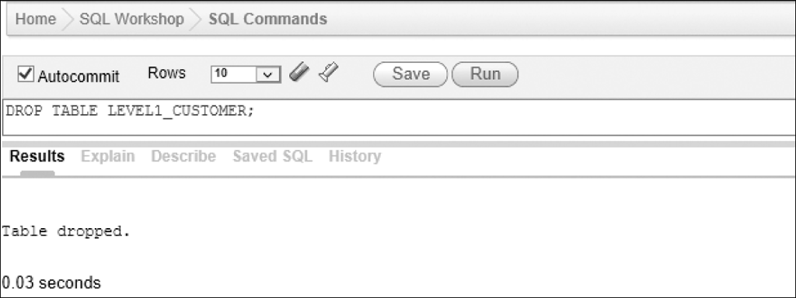
Dropping a Table (continued)
Figure 6-27: DROP TABLE command to delete the LEVEL_1_CUSTOMER table
©2016 Cengage Learning. All Rights Reserved. May not be copied, scanned, or duplicated, in whole or in part, except for use as permitted in a license distributed with a certain product or service or otherwise on a password-protected website for classroom use.

Slide 35
Summary
Use CREATE TABLE command to make a new table from an existing table
  INSERT statement containing a SELECT statement to insert data from existing table
Use UPDATE command to change data
Use INSERT command to add new rows
Use DELETE command to delete existing rows from a table
©2016 Cengage Learning. All Rights Reserved. May not be copied, scanned, or duplicated, in whole or in part, except for use as permitted in a license distributed with a certain product or service or otherwise on a password-protected website for classroom use.

Slide 36
Summary (continued)
Use COMMIT command to make changes permanent
Use ROLLBACK command to reverse updates
Use SET clause in UPDATE command to change a value to null
  Column name = NULL
  Column must accept nulls
©2016 Cengage Learning. All Rights Reserved. May not be copied, scanned, or duplicated, in whole or in part, except for use as permitted in a license distributed with a certain product or service or otherwise on a password-protected website for classroom use.

Slide 37
Summary (continued)
Use ALTER TABLE command with ADD clause to add a column to a table
Use ALTER TABLE command with MODIFY clause to change column characteristics
Use DROP TABLE command to delete a table and all its data
©2016 Cengage Learning. All Rights Reserved. May not be copied, scanned, or duplicated, in whole or in part, except for use as permitted in a license distributed with a certain product or service or otherwise on a password-protected website for classroom use.

